Slide 1
Project Name :Word Embedding With EDA
Name- Vikram Pratap Singh
Data Scientist
Email – sify.vikram@gmail.com

Slide 2
Introduction
Briefly introduce word embeddings and their importance in natural language processing.
Explain GloVe (Global Vectors for Word Representation) as a method for generating word embeddings.
Mention the relevance of Exploratory Data Analysis (EDA) in understanding and leveraging word embeddings effectively.

Slide 3
Problem Understanding
Identify the challenges in analyzing and interpreting large-scale word embeddings like GloVe.
Discuss the need to uncover hidden biases or unexpected patterns within word embeddings.
Highlight the complexity of visualizing high-dimensional data and the limitations of traditional analytical approaches.

Slide 4
Solution
Introduce Exploratory Data Analysis (EDA) as a methodology to explore and understand GloVe word embeddings.
Outline specific EDA techniques used, such as cosine similarity, clustering, and principal component analysis (PCA).
Emphasize how these techniques help in uncovering semantic relationships, biases, and structural insights within the embeddings.

Slide 5
Goal of the project
To apply EDA techniques to analyze a 300-dimensional dataset of GloVe word embeddings.
To identify and visualize meaningful patterns and relationships within the embeddings.
To investigate biases and test assumptions embedded in the word embeddings.

Slide 6
Benefits from the Project
Improved understanding of semantic relationships between words.
Identification and mitigation of biases in language models.
Enhanced capabilities in developing more accurate and inclusive natural language processing applications.

Slide 7
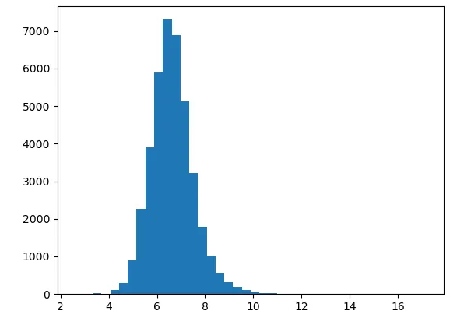
EDA
A histogram of magnitudes of our word embeddings

Slide 8
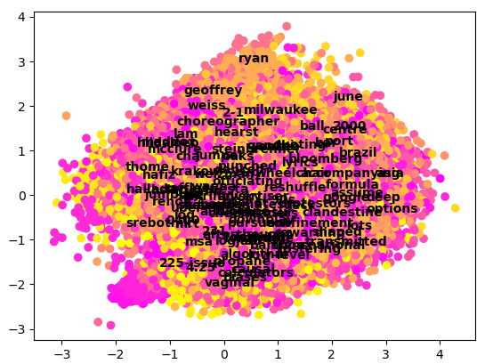
EDA
A plot of the first (X) and second (Y) principal components for our embeddings dataset

Slide 9
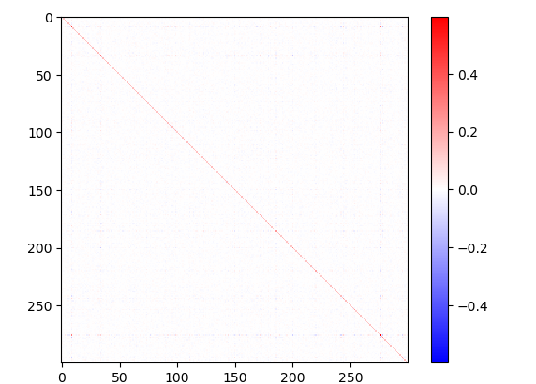
EDA
A covariance matrix for all 300 vector components in our dataset

